Slide 1
TASK 1
INTRODUCTION TO SOFTWARE DEVELOPMENT TOOLS

Slide 2
Community Service Application
“COME SERVE”

Slide 3
WHAT IS “COME SERVE”
Its is a digital platform that connects volunteers to local organizations and community service opportunities.

Slide 4
primary goal
is to facilitate volunteer participation, support community engagement, and enhance the impact of local initiatives.

Slide 5
Goals
1
Enhance Community Engagement
Foster a culture of volunteerism and civic responsibility.
2
Increase Awareness
Educate users about the various community service needs, encouraging them to participate in causes they care about.
3
Facilitate Collaborations
Connect local organizations with individuals willing to help, improving the effectiveness of community initiatives.

Slide 6
Key Features

Slide 7
User Accounts and Profiles
Registration:
Users can create personal profiles with information about their interests, skills, and availability.
Volunteer History
Users can track their past volunteer activities and accumulated hours.

Slide 8
Event Discovery
Event Listings
Organizations post opportunities for volunteering, including details such as date, time, location, and specific tasks required.
Search and Filter
Users can search for events based on categories
(e.g., education, environment, health) and filter by date or location.

Slide 9
Feedback and Reviews

Slide 11
THANK YOU
TEAM MEMBER
ASONGAFAC DESTINY
NGUALEA VIOLEI ASONGU
BANYIN MARCEL
NANA FELIZ
MAVEL

Slide 12
TASK 2
VERSION CONTROL WITH GITHUB

Slide 13
Community Service Application
“COME SERVE”
RECAP
Its is a digital platform that connects volunteers to local organizations and community service opportunities.

Slide 14
Introduction to Version control
Version control helps for tracking and managing changes to files over time
Allows multiple people to collaborate and work on files without overwritting each other’s work
Git handles local versioning

Slide 15
Objectives
Understand Git fundamentals
Learn collaboration workflow using GitHub
Demonstarate teamwork through commits, branches, and pull requests

Slide 16
Key Git Commands 02
git init
git add
git push origin main
git commit -m ‘initiative commit’

Slide 17
Key Git Commands
git pull
git branch <branch-name>
git chackout <branch-name>
git merge <branch-name>

Slide 18
Collaboration workflow 03
Each member create a new branch.
Adds new code or documentation.
Pushes their branch to GitHub.
Opens a pull request (PR) for review.
Project lead merges changes into the main branch.

Slide 19
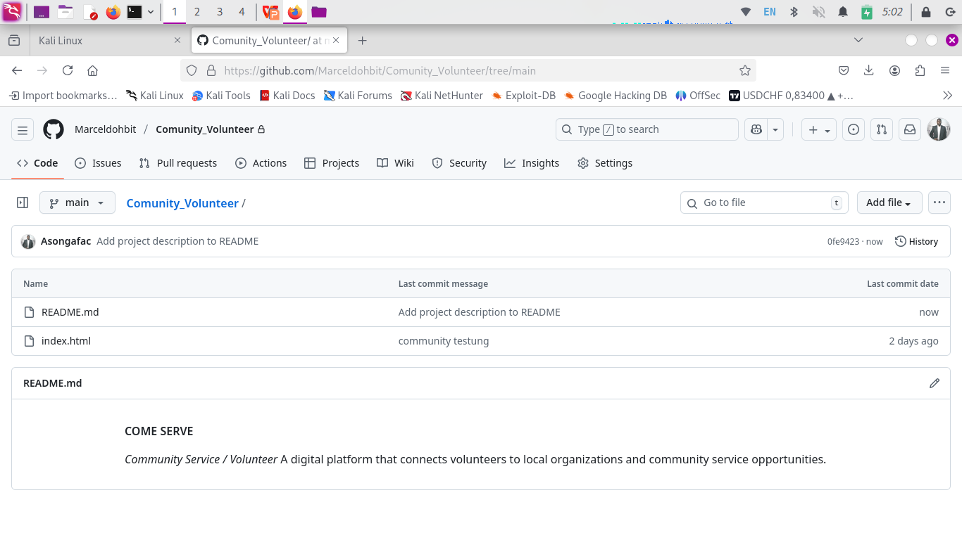
GitHub Demonstration 04
Repository: Community_Volunteer

Slide 20
Repository
Team member commits

Slide 21
GitHub outcome
merge into the main branch

Slide 22
Learning Outcome 05
Strengthened Teamwork via GitHub collaboration
Understood basic Git commands like Branching, merging and Pull Requests
Practive professional Development Workflow

Slide 23
Conclusion
With the goals of this week being archived, we can be certain that there is progress in our gollaboration skills with Git and GitHub, which is a key step in realizing this project.

Slide 24
THANK YOU
TEAM MEMBER
ASONGAFAC DESTINY
NGUALEA VIOLEI ASONGU
BANYIN MARCEL
NANA FELIZ
MAVEL

Slide 25
TASK 3
AGILE DEVELOPMENT METHODOLOGY, WITH SCRUM

Slide 26
Task 01. introduction Task 02. version control with git and GitHub Today: AGILE DEVELOPMENT METHODOLOGY, WITH SCRUM
“COME SERVE”
RECAP
Its is a digital platform that connects volunteers to local organizations and community service opportunities.

Slide 27
AGENDA
What is Agile?
Introduction to the Scrum Framework
Scrum Roles & Responsibilities
Scrum Events
Our Tool: Trello.io

Slide 28
WHAT IS AGILE?
AGILE is a project management aproach that emphasizes flexibility, collaboration and continuous delivery.
The agile values:
· Individuals and Interactions over processes and tools
· Working Software over comprehensive documentation
· Customer Collaboration over contract negotiation
· Responding to Change over following a plan

Slide 29
Why it Matters for "Come Serve"
Our project requirements are detailed but can evolve.
We need to deliver working features incrementally.
It allows us to get feedback early and adapt.

Slide 30
WHAT IS SCRUM? 02
Scrum is a lightweight, iterative, and continous Agile framework for managing complex project development.

Slide 31
The Three Scrum Roles
1. The Product Owner
Represents the stakeholders and the voice of the customer.
Defines the features of the product (the "What").
Manages the Product Backlog.
For "Come Serve": Both team members share this role, defining features from our project document.

Slide 32
2. The Development Team
· A cross-functional group who do the work of delivering a "Done" increment.
· Self-organizing; decides how to get the work done.
· For "Come Serve": we all are the developers.

Slide 33
3. The Scrum Master
· Ensures the team follows Scrum theory, rules, and practices.
· Removes impediments for the team.
· For "Come Serve": We will rotate this role weekly.

Slide 34
Our Tool of Choice: Trello.io 03
WHY?
It has a Freemium plan with powerful features
Excellent support for Scrum.
Easy to understand interface for managing User Stories, Sprints, and Tasks.

Slide 35
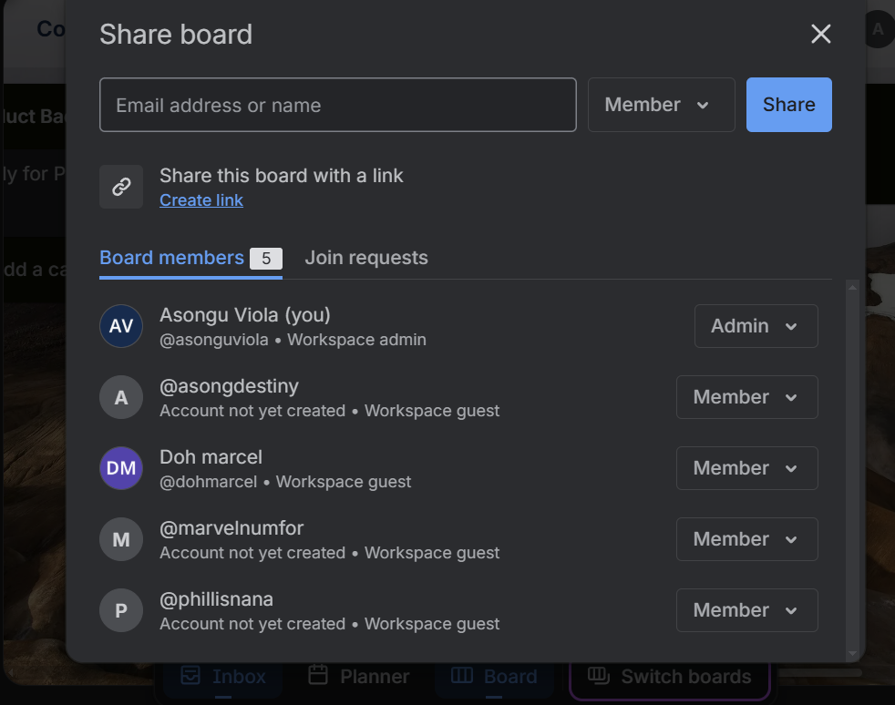
collaboration
Everyone was invited via email so we can all track our work and progress from our indiviual PC and locations.
We have an admin who oversees the collaboration workflow while others are members

Slide 36
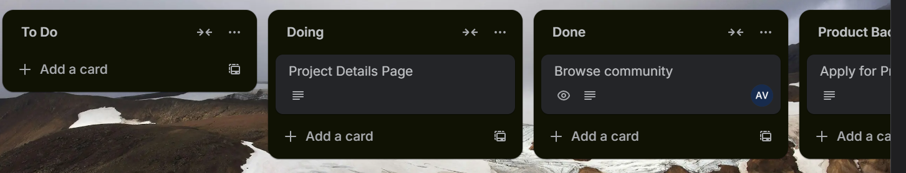
TASKS TO BE DONE WITH TRELLO
different cards were created for tracking our workflow, ensuring progress and ease management

Slide 37
DIFFERENT CARDS CREATED: 04
TO-DO
list of activities about to be done. helps us progress continuously.
DOING
what we currently working on. In progress tasks
DONE
completed activities

Slide 38
PRODUCT BACKLOCK
list of tasks to be done based on the user’s feedbacks and reviews
SPRING BACKLOCH
list of tasks and items that the our team will be commited to doing

Slide 39
IN PPROGTRESS
what we are currently working on
TESTING
confirming functionality of the completed tasks

Slide 40
SPRINT ONE 05
A sprint is a priority task to be done within a short period of time, usually 1 to 4 weeks.
for our project, our prefered sprint will be 1 to 2 week

Slide 41
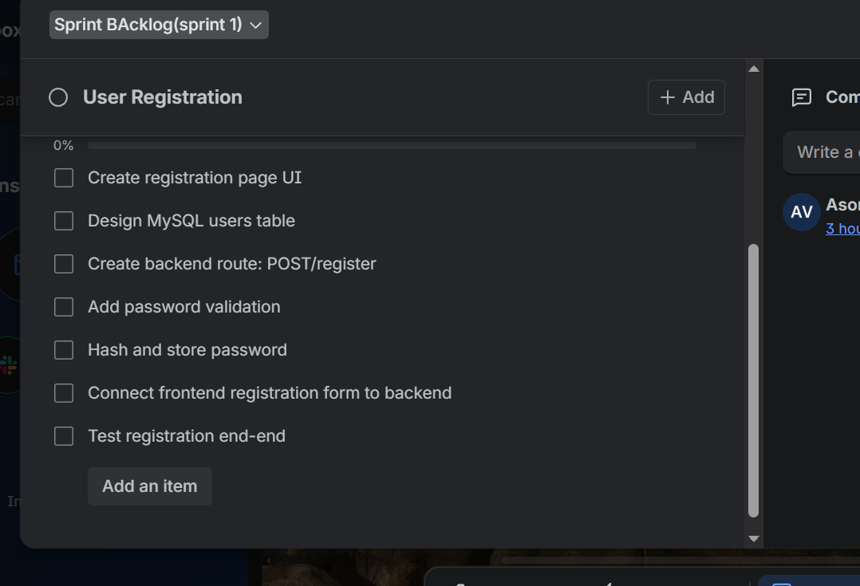
SPRINT ONE: TASKS
The first activity of our sprint is focused on USER REGISTRATION with details as shown on the image beside

Slide 42
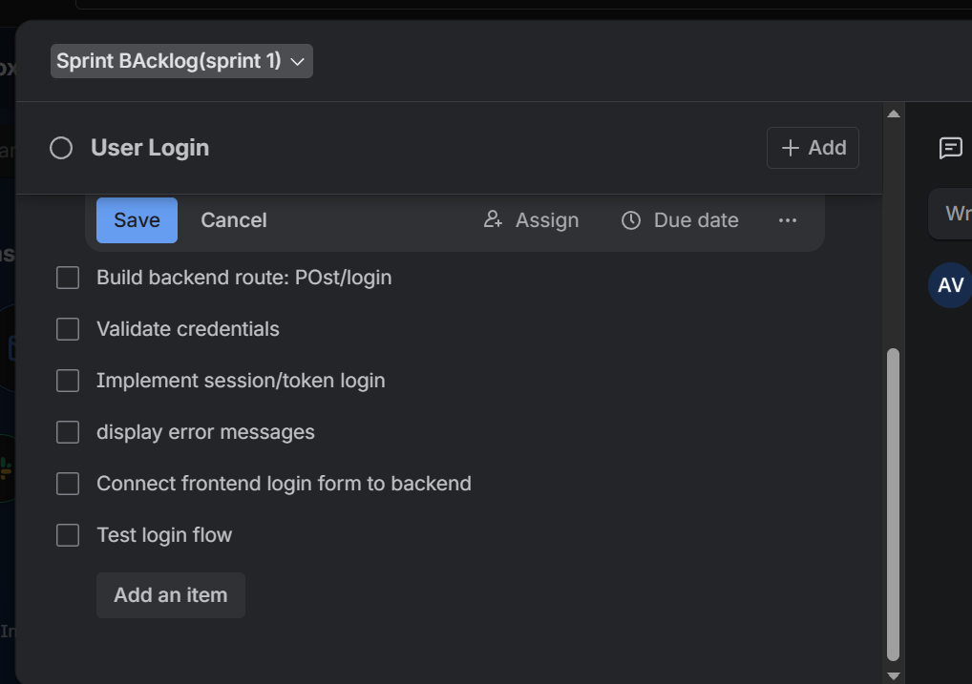
SPRINT ONE: TASKS
Our next activity on sprint one is the USER LOGIN with more details shown on the image beside

Slide 43
SPRINT TWO
The next activity for our project will be the sprint two, were we will:
Demonstrating IDE setup and run codes
and practice debugging in VS code

Slide 44
Conclusion
In conclusion, we have effectively transformed Come Serve from a concept into a fully operational Agile project.
Establishing our Scrum framework, setting up and prioritizing our Trello Product Backlog, completing our first Sprint Planning with a clear Sprint Goal and actionable tasks, and aligning every line of code to strategic user stories.

Slide 45
THANK YOU
TEAM MEMBER
ASONGAFAC DESTINY
NGUALEA VIOLEI ASONGU
BANYIN MARCEL
NSEMEN PHILLIS NANA
NWUFOR MAVELLOUS

Slide 46
TASK 4
INTEGRATED DEVELOPMENT ENVIRONMENT (IDE)

Slide 47
previously... Task 03. Agile development methodology with scrum Today: INTEGRATED DEVELOPMENT ENVIRONMENT (IDE)
“COME SERVE”
RECAP
Its is a digital platform that connects volunteers to local organizations and community service opportunities.

Slide 48
AGENDA
introduction to IDE
introduction to VS Code
obtaining VS code
basic setting up
demo
conclusion

Slide 49

INTRODUCTION
WHAT IS AN IDE
is a software application that combines essential tools for software development into one interface to boost productivity

Slide 50
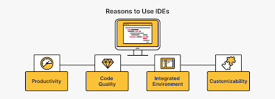
IMPORTANCE OF IDEs

Slide 51
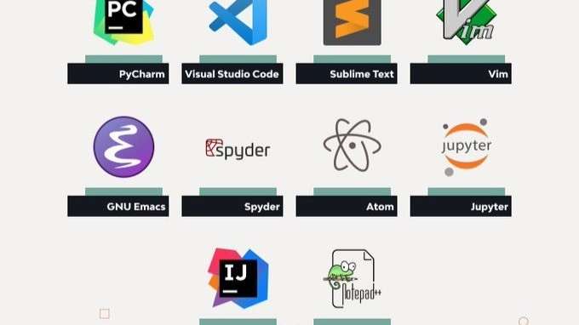
TYPES OF IDE

Slide 52

OUR CHOICE OF IDE 02
VISUAL STUDIO CODE
It is a free and powerful source-code editor developed by Microsoft and publishes on April 29, 2015
The current stable version is 1.106.0, released on November 12, 2025.

Slide 53

WHY DID WE CHOOSE VS CODE?
Free and Open-Source
Cross-Platform Compatibility
Lightweight yet Powerful
Vast Extension Ecosystem
Integrated Git Support
Integrated Terminal

Slide 54

HOW TO GET VS CODE (windows) 03
Download the installer (https://code.visualstudio.com/download)
Run the installer
Accept the license agreement
Choose install location (optional)
follow steps...

Slide 55
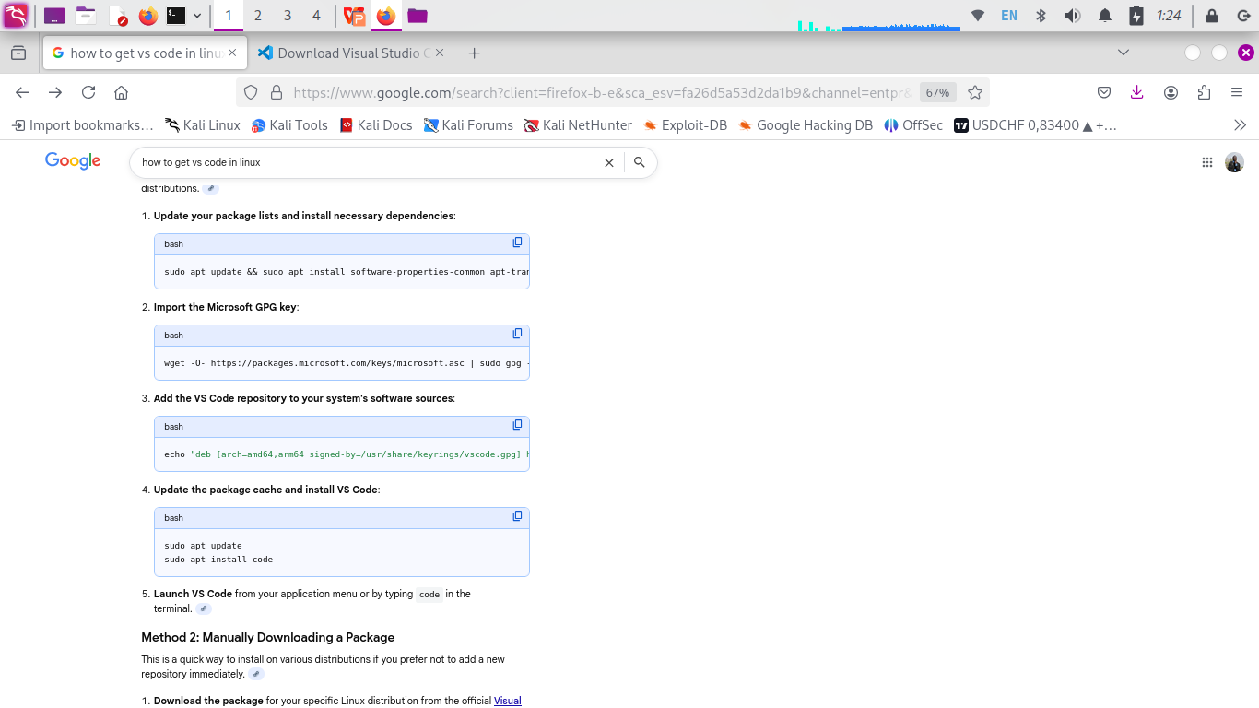

HOW TO GET VS CODE (linux)

Slide 56
BASIC VS-CODE SET-UP 04
Step 1: Install Visual Studio Code (Explain above)
Step 2: Set up Your Workspace
VS Code is designed to work with project folders rather than individual files
- Create a new folder on your computer for your project files.
- In VS Code, go to File > Open Folder (or Open... on macOS) and select the folder you created.
- If prompted about Workspace Trust, select "Yes, I trust the authors" to enable all features within that workspace.

Slide 57
BASIC VS-CODE SET-UP
Step 3: Install Essential Extensions
Extensions are key to customizing VS Code for our specific needs, adding language support, debuggers, and tools
Extensions relevant to our project:
copilot
liveserver
project manager
GitHub
live code
Live Share
GitLens
IntelliSense
VS code icons

Slide 58
BASIC VS-CODE SET-UP
Step 4: Configure Settings (Optional)
You can customize almost every part of VS Code through its settings.
Open the Settings Editor by pressing Ctrl+, (or Cmd+, on macOS) or via File > Preferences > Settings.
Auto Save: In the settings search bar, type "Auto Save" and change the value from Off to afterDelay or onWindowChange so you don't lose work.
Explore other settings like color themes, font size (Ctrl++ to zoom in), and integrated terminal shell.

Slide 59
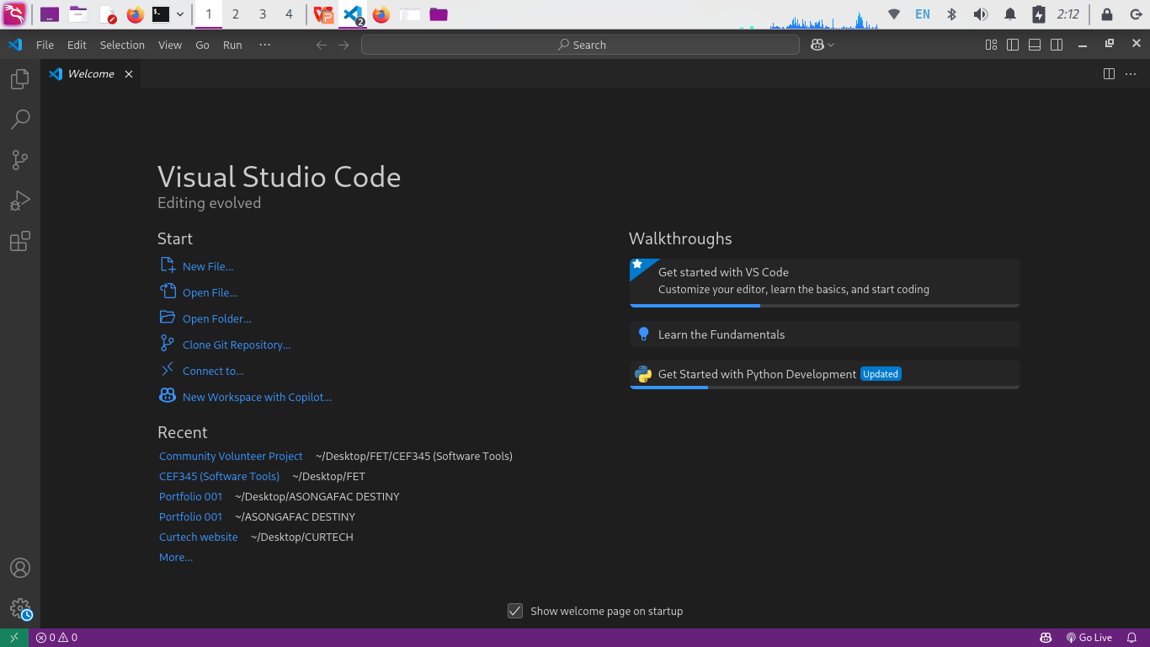
DEMO 05
HOME VIEW

Slide 60
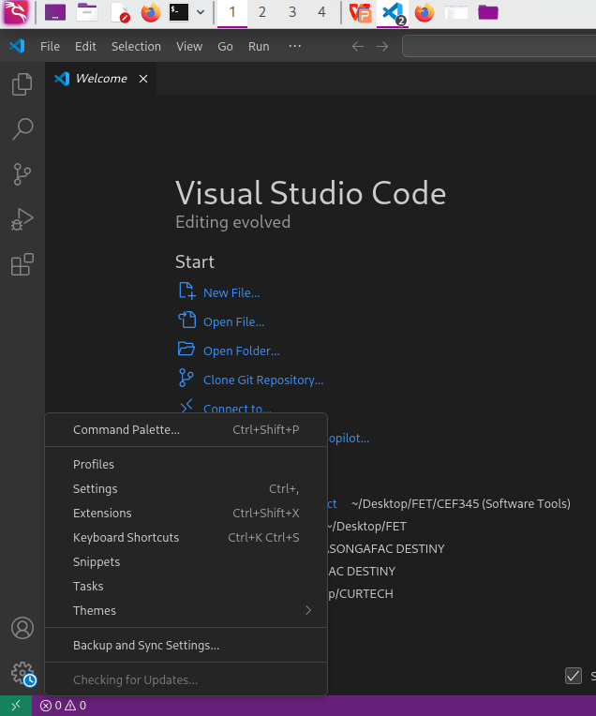
DEMO
SETTINGS

Slide 61
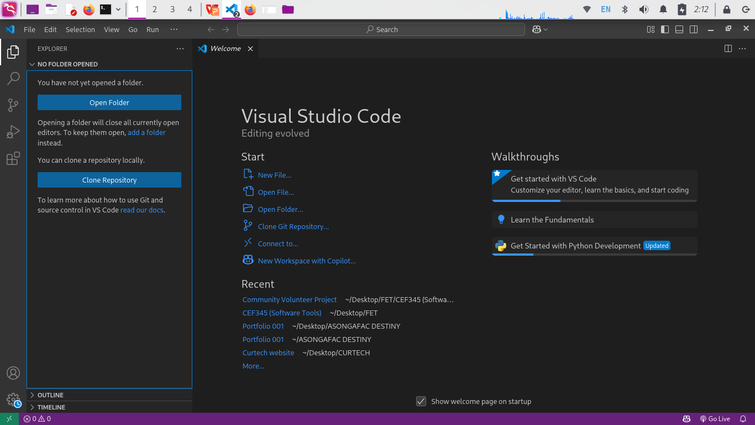
DEMO
EXPLORE PAGE

Slide 62
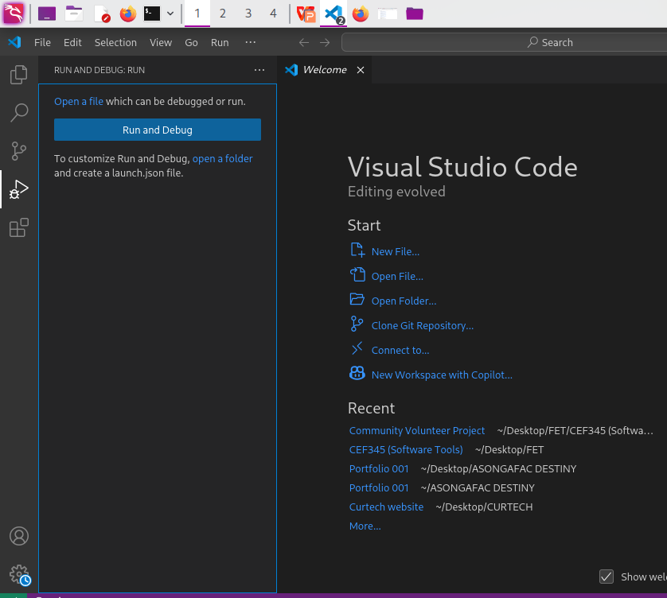
DEMO
RUN AND DEBUG

Slide 63
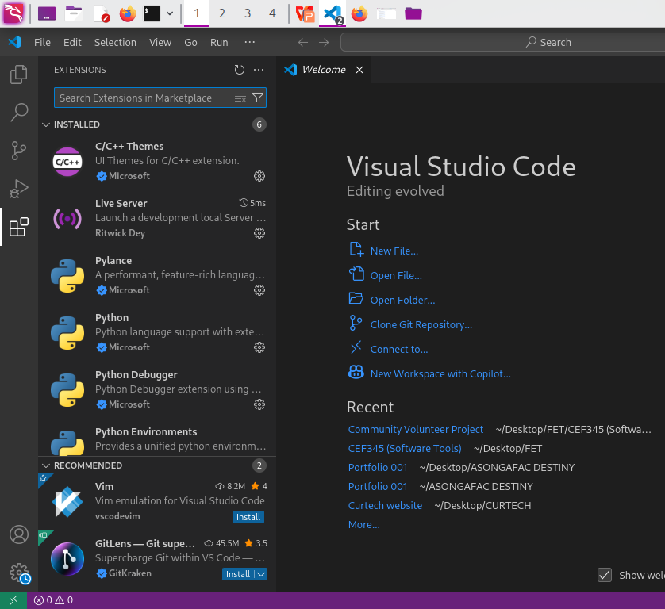
DEMO
EXTENSIONS

Slide 64
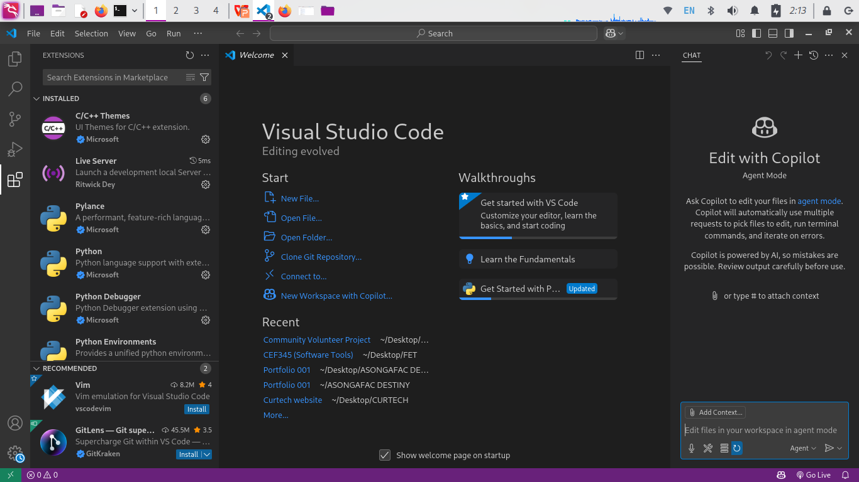
DEMO
COPILOT

Slide 65
Conclusion
In conclusion, understanding the full functionality of VS code, how it works and its key functionalities is a huge step for our project, since it will be used for over 80% of the actual work.
Hence work has began!

Slide 66
THANK YOU
TEAM MEMBER
ASONGAFAC DESTINY
NGUALEA VIOLEI ASONGU
BANYIN MARCEL
NSEMEN PHILLIS NANA
NWUFOR MAVELLOUS

